Slide 1
Utilizing R for Automated Extraction and Comprehensive Analysis of Resolution Values from Protein Data Banks
By
David A. OBE.

Slide 2
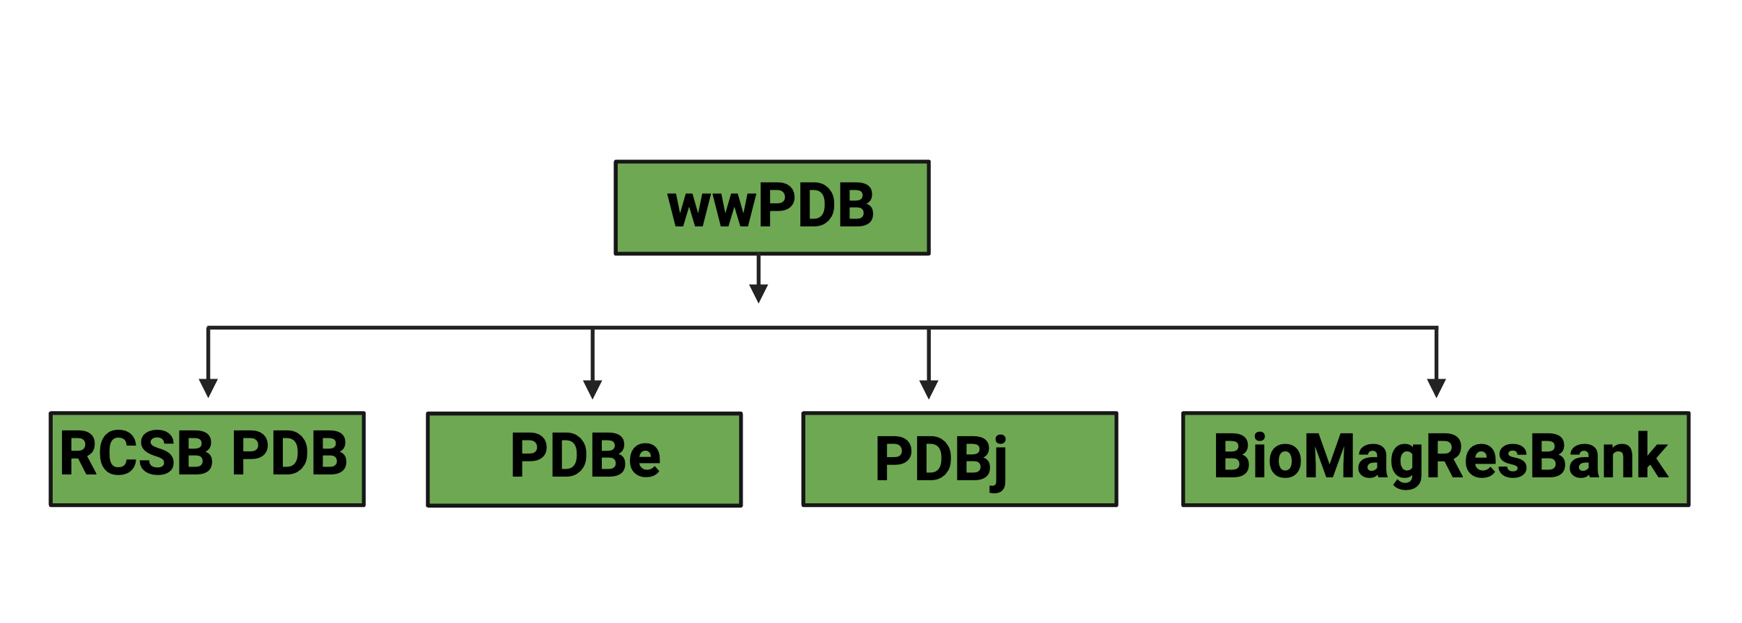
4 Musketeers defend the PDB

Slide 3
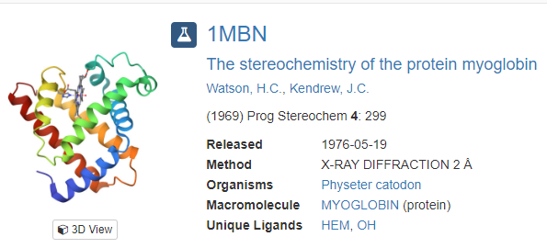
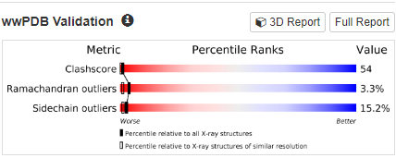
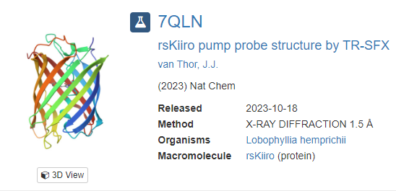
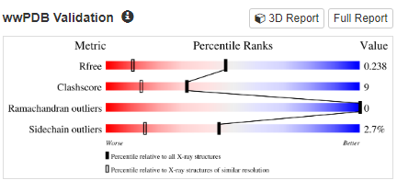
1969 – 2023 what changed?

Slide 4
Conclusion
The proposed research will contribute to the advancement of structural biology and related fields by providing valuable insights into the quality of structural data, which has far-reaching implications in various scientific endeavors.

